Slide 1

Introduction to Locomotor & Multiple Disabilities
Unit 4: Deaf-Blindness

Slide 2
Unit 4: Deaf-Blindness
Definition, causes, classification, prevalence and characteristics of deaf-blindness
Effects and implications of deaf-blindness on activities of daily living & education
Screening, assessment, identification & interventional strategies of deaf-blindness
Fostering early communication development: Methods, assistive devices and practices including AAC
Addressing orientation, mobility and educational needs of students with deaf-blindness

Slide 3
Unit 4: Deaf Blindness
Definition, causes, classification, prevalence and characteristics of deaf-blindness
Effects and implications of deaf-blindness on activities of daily living & education
Screening, assessment, identification & interventional strategies of deaf-blindness
Fostering early communication development: Methods, assistive devices and practices including AAC
Addressing orientation, mobility and educational needs of students with deaf-blindness

Slide 4
Screening…
3 Sources of Information
Medical Reports
Interaction with Caregivers
Direct Observation

Slide 5
…Screening…
Observe for symptoms
HEARING
Ear discharge and/or pain
VISION
Lack of response to specific sounds (soft, shrill, from behind, etc.)
Defective speech
Difficulty understanding & responding to speech
Excessive use of gestures
Secretion/ sore/ squint/ swelling in eyes
Straining close to focus at things in hand
Bumping into things when moving
Complaining of too little/ too much light
Rubbing/ squeezing eyes
Voice abnormalities

Slide 6
…Screening…
Review medical records for –
  History of syndromes
  Maternal infections
  Prematurity
  Low APGAR score
  Congenital deformities
  Childhood infections
  Other risk factors

Slide 7
…Screening
Find out from caregivers about
  Family health history
  Developmental history of child
  Medical history of child
  Daily life functional activities of the child
    Hearing
    Vision
    Cognition
    Personal care
    Socio-behavioural/ Play
  Culminates with guidance to appropriate medical and/or rehabilitation professionals

Slide 8
Assessment…
Formal Clinical/ Medical Assessment
  Vision
    Structure of eye
    Test with Snellen chart for distant vision
    Test for near vision with printed symbols at closer range
    Functional vision assessment for practical use in real life situations
  Hearing
    Structure of ear
    Pure tone & speech audiometry
    Objective tests like ABR , impedance audiometry, etc.
    Test for aided hearing abilities
  Tests in other necessary domains like – cognition, behaviour, etc.

Slide 9
…Assessment…
Special Tools for Identifying Needs in Deaf-Blind Children
  Caller-Azusa Scale
    Development scale for comprehensive assessment of deaf-blind children
    Has 18 sub-scales in 6 areas → motor development, perceptual development, daily living skills, cognition, communication & language, and social development
  Learning thru’ Doing
    Programme manual developed by Blind Persons Association (BMA) & National Institute of Visual Handicap (NIVH) in 2002
    Helpful in evaluating & training in areas of → personal care, orientation & mobility, social areas, functional academics & independent living/vocational skills
  Test for Functional Assessment of Vision & Hearing
    Questionnaire for assessing functional hearing & vision
    Developed by Sense International (India)

Slide 10
…Assessment
Audiology
Ophthal-mology
Orientation & Mobility
Physical
Intelligence
Adaptive Behaviour
Communi-cation
Functional & Vocational

Slide 11
Intervention…
General Guidelines...
  Need for rapport building & strong bonding with client
  Maximal use of residual ability
  Personalise goals & strategy acc’ to individual –
  Flex cultural & societal norms – like in use of ‘touch’ in interpersonal interaction
  Treat client with dignity & give space of individual preferences in decision making
  Positivity, patience & perseverance

Slide 12
…Intervention…
Specific Strategies…
  COMPREHENSIVE targets for integrated intervention
    Motor development
    Perceptual development
    Daily living skills
    Cognition
    Communication & language
    Social engagement
  SCAFFOLD of assistance
    Physical assistance
    Verbal and/or tactual guidance
    Semi-verbal or tactual prompts
    Function with monitoring
    Independent functioning
  Aim at maximising independence

Slide 13
…Intervention…
Follow STRUCTURED Training Routines – with consistency in
  Steps of training
  Methods of training
  Materials used in training
  Persons involved in training
  Client has to be alerted regarding any change with proper explanation
Adopt Convenient TIME MANAGEMENT
  Optimal time for training
  More time for practising
  Interspersed with necessary breaks & diversions

Slide 14
…Intervention
Incorporate ONGOING MONITORING & EVALUATION…
  Criterion-based
  Individualised
  Incidental
  Informative (with recorded data & samples of performance)
Ensure Participation of STAKEHOLDERS
  Involve the family
  Make use of social resources
  Public awareness & advocacy – extension of interventional services

Slide 15
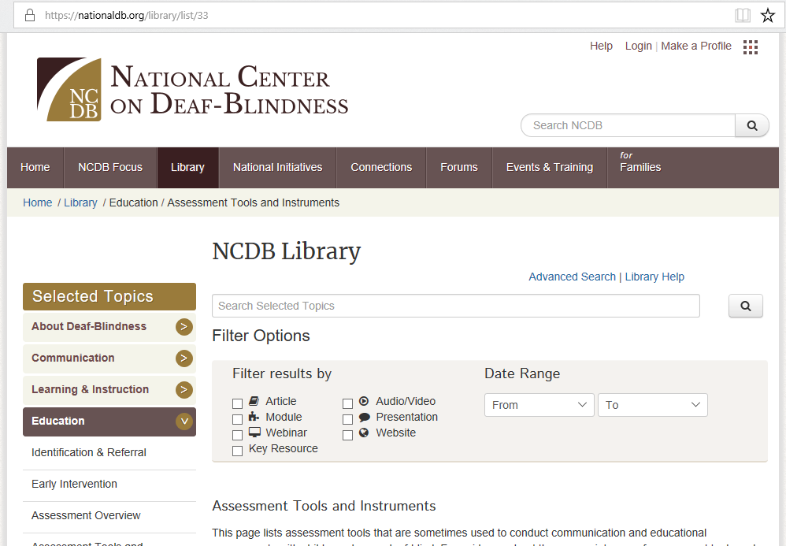
Enhance Your Knowledge…
If you are interested in learning further about tools to screen and/or assess you can access webpage of National Centre of Deaf-Blindness https://nationaldb.org/library/list/33 for list of useful tools with hyperlinked details:

Slide 16

Further on…
The ensuing section will help you become aware how a child with deaf-blindness can be helped to develop early communication skills, in spite of having difficulty with the two crucial senses necessary for communication…

